Slide 1
Considerations for Bayesian Methods with Informative Priors
James Travis
Lead Mathematical Statistician
FDA/CDER/OTS/OB/DB II

Slide 2
Disclaimer
This presentation reflects the views of the author and should not be construed to represent FDA’s views or policies

Slide 3
PDUFA VII
Objective: Continue to facilitate the advancement and use of complex innovative designs
Develop staff capacity
Continue paired meeting program
Convene a public workshop
Publish draft guidance

Slide 4
PDUFA VII
FDA will continue to develop staff capacity and engage external experts
Continuation of CID Paired Meeting Program
Announced in Federal Register Notice, which outlines eligibility, proposal submission, selection process, and examples
FDA will select up to 8 proposals per year
Information disclosure

Slide 5
PDUFA VII
Convene a public workshop
Considerations for external data sources
Bayesian statistical methods
Simulations
Clinical trial implementation
Publish draft guidance on the Use of Bayesian Methodology in Clinical Trials of Drugs and Biologics

Slide 6
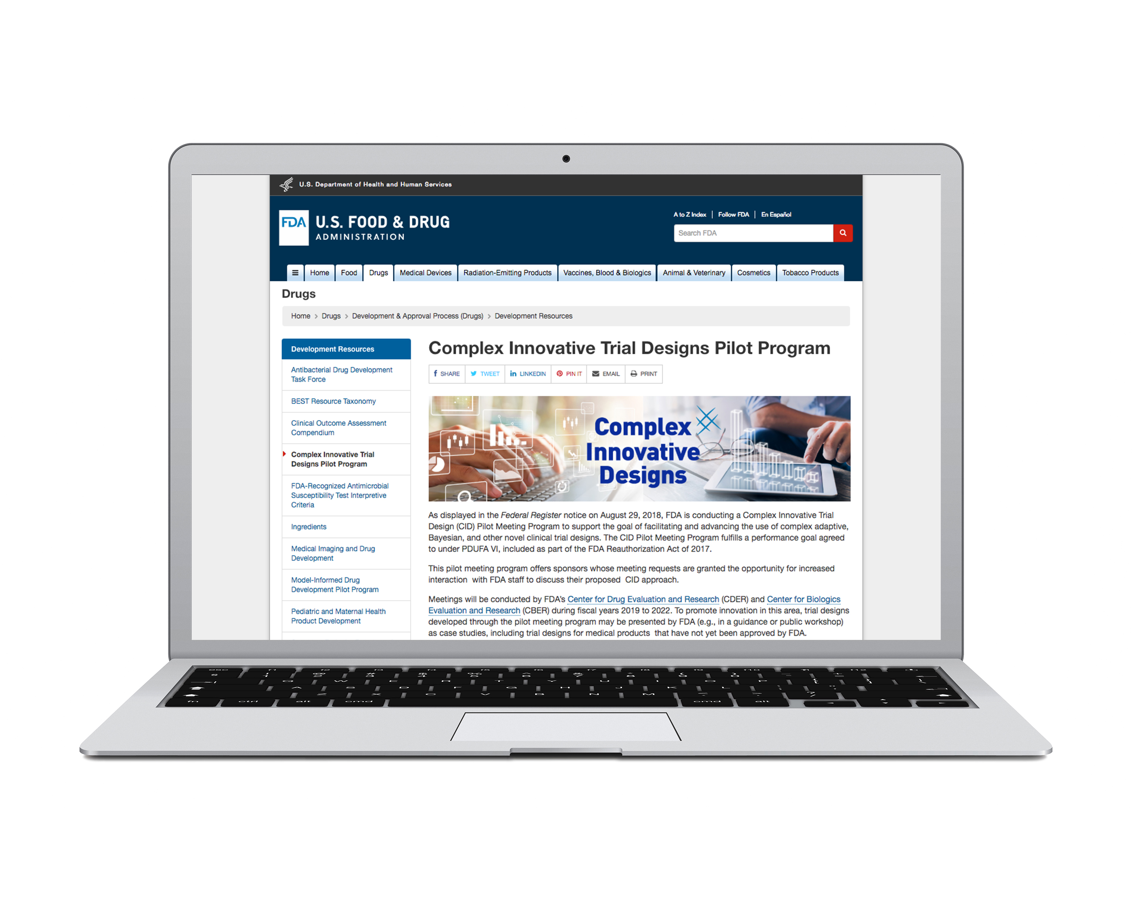
Website
https://www.fda.gov/drugs/development-resources/complex-innovative-trial-design-meeting-program

Slide 7
FDA Publications
Summary of the program so far (Published 2021):
https://www.fda.gov/media/155406/download
Case Studies:
Master protocol: https://www.fda.gov/media/155403/download
Lupus: https://www.fda.gov/media/155404/download
DLBCL: https://www.fda.gov/media/155405/download
Bayesian Methods in Human Drug and Biological Products Development in CDER and CBER
https://doi.org/10.1007/s43441-022-00483-0
FDA-M CERSI: Advancing the Development of Pediatric Therapeutics Complex Innovative Trial Design Public Workshop
https://www.fda.gov/drugs/news-events-human-drugs/fda-m-cersi-advancing-development-pediatric-therapeutics-complex-innovative-trial-design-public

Slide 8
Discussion
Bayesian Decision Rules
Informative Priors
Dynamic vs Static Priors
Adaptive Trials with Informative Priors
Simulations
Sensitivity Analyses

Slide 9
Bayesian Decision Rules

Slide 10
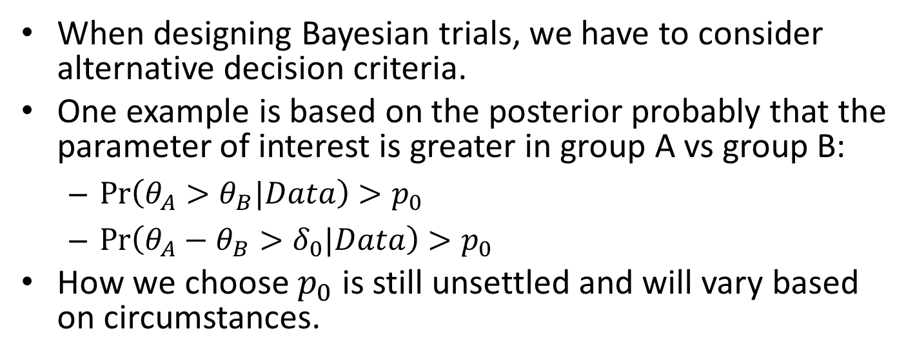
Bayesian Decision Rules
When designing Bayesian trials, we have to consider alternative decision criteria.
One example is based on the posterior probably that the parameter of interest is greater in group A vs group B:
$\operatorname{Pr}\left(θ_{A}>θ_{B}|Data\right)>p_{0}$
$\operatorname{Pr}\left(θ_{A}−θ_{B}>δ_{0}|Data\right)>p_{0}$
How we choose $p_{0}$ is still unsettled and will vary based on circumstances.

Slide 11
Informative Priors

Slide 12
Informative Priors
This is most common in pediatrics, but was also considered in other situations in the CID program:
Borrowing across treatments/diseases in a master protocol setting;
Borrowing control information from external data;
Borrowing across dose groups.

Slide 13
Types of Priors
For the borrowing, there were multiple types of methods and priors considered:
Hierarchical priors
Robust meta-analytic priors
Propensity scores matched dynamic borrowing

Slide 14
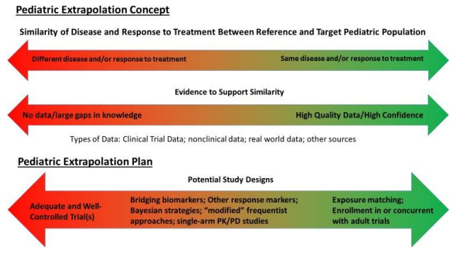
Pediatric Extrapolation
https://www.fda.gov/media/161190/download

Slide 15
Challenges with Informative Priors
“When external information is explicitly borrowed into a design, such as in a Bayesian framework, a rationale for the borrowing and an explanation of how the prior distributions were constructed from the prior information.”
How do we assess if a prior is reasonable?

Slide 16
Measuring the Impact of Borrowing
What it says about the outcome (prior probability of efficacy)
Impact on key operating characteristics (chance of erroneous conclusion/Power)
How much information it contributes (effective sample size)
Pennello G, Thompson L. Experience with reviewing Bayesian medical device trials. J Biopharm Stat. 2008;18(1):81-115. doi: 10.1080/10543400701668274.

Slide 17
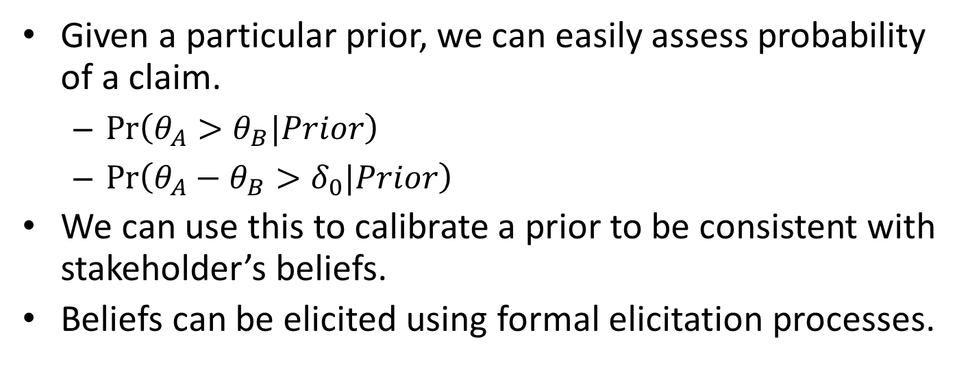
Prior Probability of a Claim
Given a particular prior, we can easily assess probability of a claim.
$\operatorname{Pr}\left(θ_{A}>θ_{B}|Prior\right)$
$\operatorname{Pr}\left(θ_{A}−θ_{B}>δ_{0}|Prior\right)$
We can use this to calibrate a prior to be consistent with stakeholder’s beliefs.
Beliefs can be elicited using formal elicitation processes.
O'Hagan, Anthony, et al. "Uncertain judgements: eliciting experts' probabilities." (2006).

Slide 18
Chance of Erroneous Conclusions
We can easily compare to typical values (1-sided 2.5% and 2-sided 5%).
Two challenging question when using it to calibrate the prior:
How much inflation is reasonable in a situation?
Is it meaningful in a particular situation?

Slide 19
Chance of Err. Conclusions Cont’d
Most salient example is in pediatric development.
We have a drug that has been demonstrated to have an effect in adults.
If we know the disease process/mechanism is similar in children, then we might think it unlikely then that the drug has no effect in children.

Slide 20
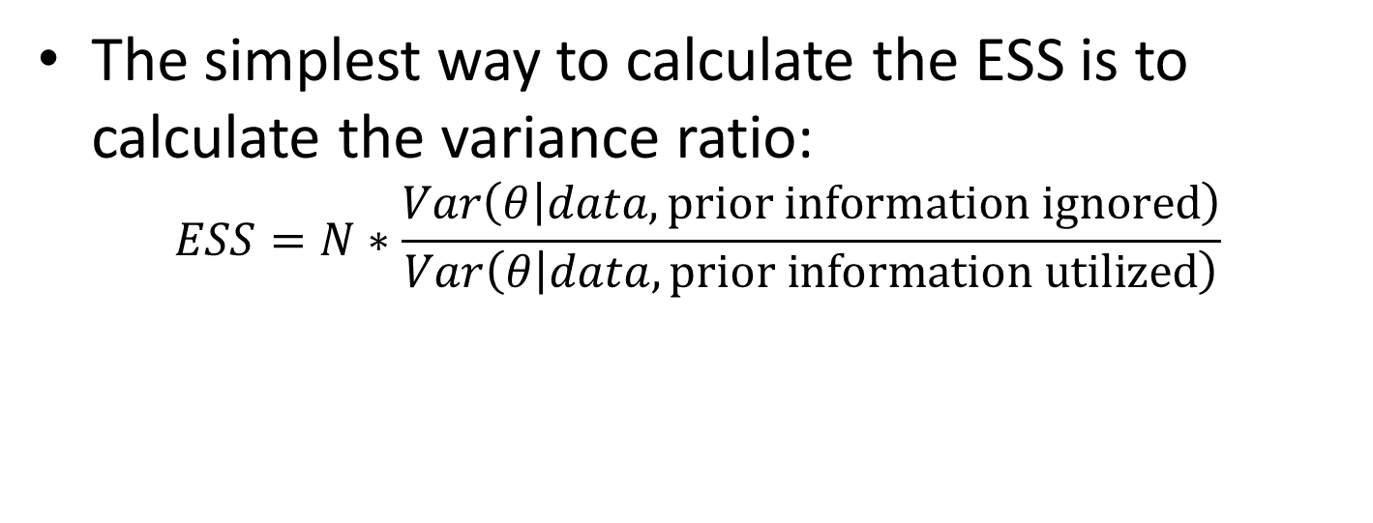
Effective Sample Size
The simplest way to calculate the ESS is to calculate the variance ratio:
$$ESS=N∗\frac{Var\left(θ | data, \text{prior} \text{information} \text{ignored}\right)}{Var\left(θ | data,\text{prior} \text{information} \text{utilized}\right)}$$

Slide 21
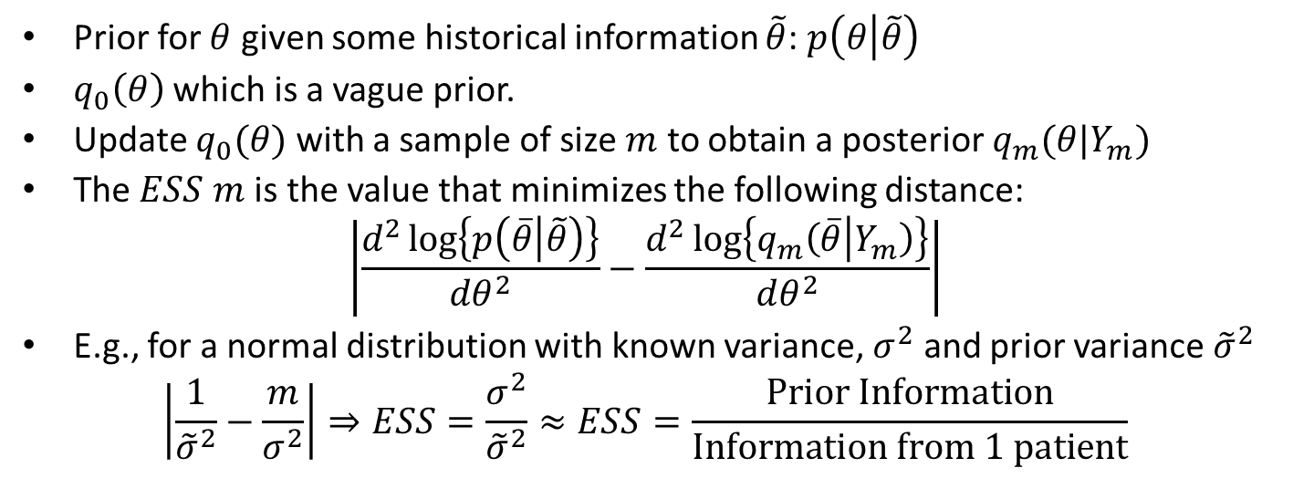
ESS – Morita-Thall-Mueller
Prior for $θ$ given some historical information $\tilde{θ}$: $p\left(θ | \tilde{θ}\right)$
$q_{0}\left(θ\right)$ which is a vague prior.
Update $q_{0}(θ)$ with a sample of size $m$ to obtain a posterior $q_{m}(θ|Y_{m})$
The $ESS$ $m$ is the value that minimizes the following distance:
$$\left|\frac{d^{2}\log\left\{p\left(\overline{θ} | \tilde{θ}\right)\right\}}{dθ^{2}}−\frac{d^{2}\log\left\{q_{m}\left(\overline{θ} | Y_{m}\right)\right\}}{dθ^{2}}\right|$$
E.g., for a normal distribution with known variance, $σ^{2}$ and prior variance ${\tilde{σ}}^{2}$
$$\left|\frac{1}{{\tilde{σ}}^{2}}−\frac{m}{σ^{2}}\right|⇒ESS=\frac{σ^{2}}{{\tilde{σ}}^{2}}≈ESS=\frac{\text{Prior} \text{Information}}{\text{Information} \text{from}\text{ 1 }\text{patient}}$$
Morita, S., Thall, P. F., & Müller, P. (2008). Determining the effective sample size of a parametric prior. Biometrics, 64(2), 595-602.

Slide 22
Dynamic vs Static Priors

Slide 23
Dynamic vs Static Priors
Dynamic priors adapt the level of borrowing to some measure of similarity between the source and the target data.
Examples: commensurate priors, mixture priors, elastic priors, hierarchical models.
Advantages:
Can provide better operating characteristics relative to a static prior where a constant amount of information is used.
Added challenges:
More decisions to make on tuning parameters
Quantifying the variable degree of borrowing

Slide 24
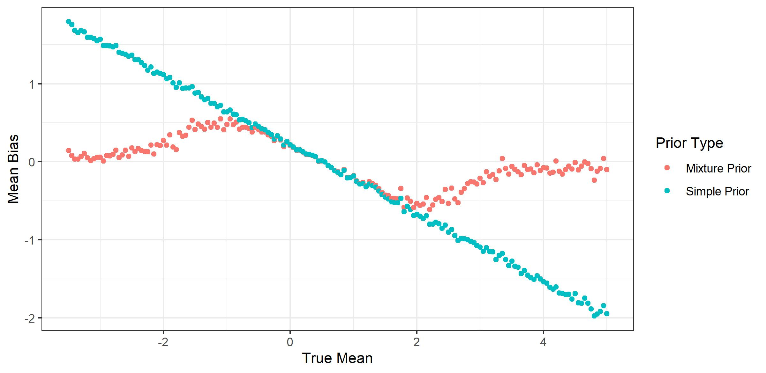
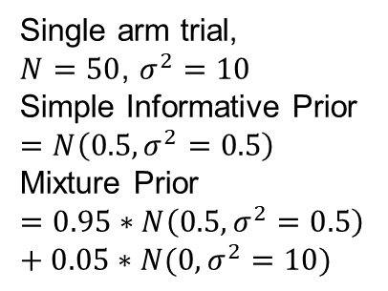
Bias
Single arm trial,
$N=50$, $σ^{2}=10$
Simple Informative Prior $$=N\left(0.5, σ^{2}=0.5\right)$$
Mixture Prior
$$=0.95∗N\left(0.5, σ^{2}=0.5\right)+0.05∗N(0, σ^{2}=10)$$

Slide 25
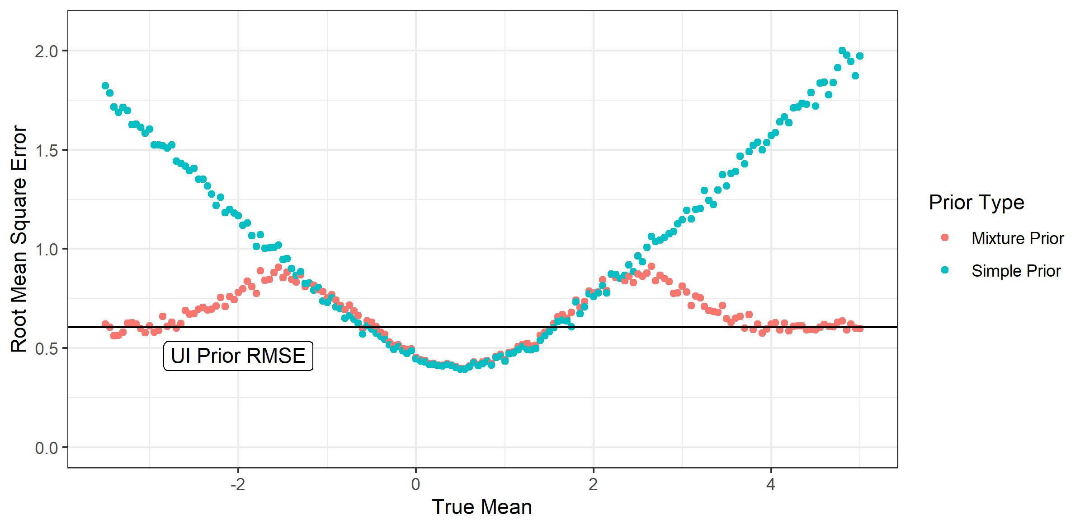
Mean Square Error

Slide 26
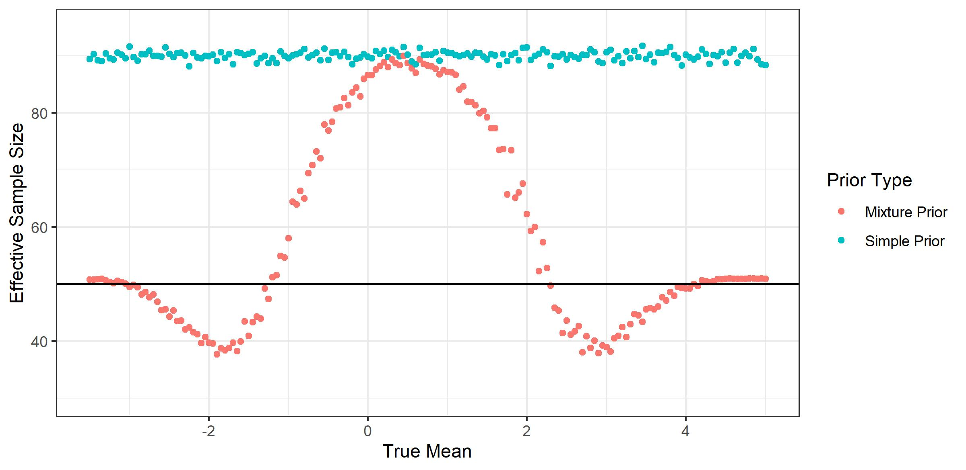
Dynamic vs Static Priors
↑ Precision gain
↓ Precision loss

Slide 27
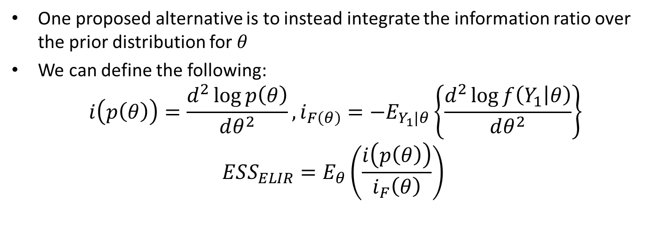
ESS – Expected Local Information Ratio
One proposed alternative is to instead integrate the information ratio over the prior distribution for $θ$
We can define the following:
$$i\left(p\left(θ\right)\right)=\frac{d^{2}\log{p\left(θ\right)}}{dθ^{2}}, i_{F\left(θ\right)}=−E_{Y_{1}|θ}\left\{\frac{d^{2}\log{f\left(Y_{1} | θ\right)}}{dθ^{2}}\right\}$$
$$ESS_{ELIR}=E_{θ}\left(\frac{i\left(p\left(θ\right)\right)}{i_{F}\left(θ\right)}\right)$$
Neuenschwander, B., Weber, S., Schmidli, H., & O'Hagan, A. (2020). Predictively consistent prior effective sample sizes. Biometrics, 76(2), 578-587.
Weber S, Li Y, Seaman JW, Kakizume T, Schmidli H (2021). “Applying Meta-Analytic-Predictive Priors with the R Bayesian Evidence Synthesis Tools.” Journal of Statistical Software, 100(19), 1–32. doi: 10.18637/jss.v100.i19.

Slide 28
Adaptive Trials and Informative Priors

Slide 29
Adaptive Trials with Informative Priors
Informative Bayesian priors combined with adaptive trials can provide some interesting approaches.
For example, we can use a skeptical prior to control the chance of erroneous conclusion
Ye, J., Reaman, G., De Claro, R. A., & Sridhara, R. (2020). A Bayesian approach in design and analysis of pediatric cancer clinical trials. Pharmaceutical Statistics, 19(6), 814-826.

Slide 30
Challenges
Calibration and operating characteristic simulation are much more complicated and time consuming.
There are also philosophical challenges – if we are in a situation where we are borrowing information and in an adaptive setting, how do we decide a decision threshold?

Slide 31
Regulatory Consistency
Suppose we have two programs seeking the same indication.
One uses a non-adaptive design with just a single analysis following the trial.
The other uses an adaptive design, with multiple interim efficacy analyses.
How do we ensure fairness/consistency between the programs?

Slide 32
Simulations

Slide 33
Goal of Simulations
In these types of complex designs we typically need simulations in order to understand the operating characteristics of a particular design.

Slide 34
Important Operating Characteristics
Power
Chance of erroneous conclusions
Bias
Variance of estimator
Effective sample size

Slide 35
Best Practices for Simulations
Key challenge is communication.
As regulators, we need to understand the model, the simulated scenarios, the assumptions.
There needs to be a strong focus on readability and transparency.

Slide 36
Sensitivity Analyses

Slide 37
Sensitivity Analyses
Need to pay more attention to the design of sensitivity analyses.
They are just at least as important as sensitivity analyses for missing data.

Slide 38
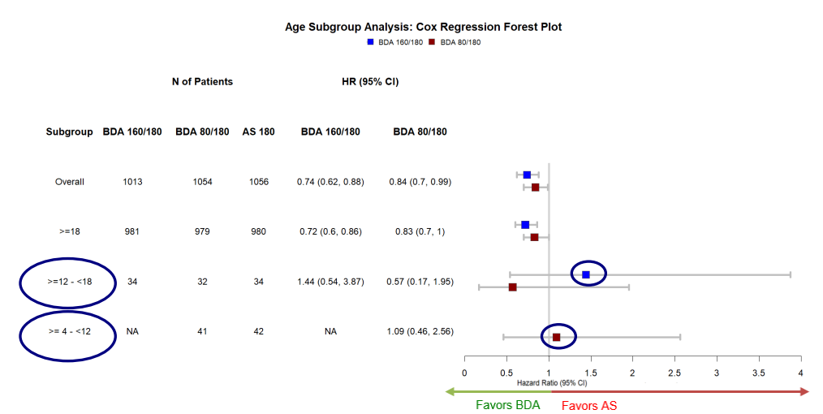
Example Pediatric Asthma (1/2)
https://www.fda.gov/media/162919/download

Slide 39
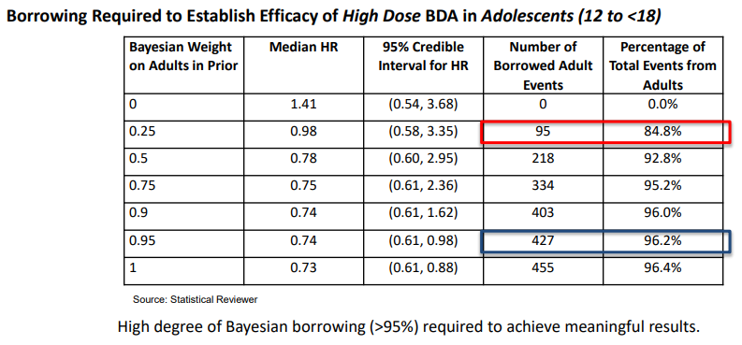
Example Pediatric Asthma (2/2)

Slide 40
Summary
The CID program has been helpful in driving discussion and acceptance of innovative trials.
Discussions on degree of borrowing and calibration are still challenging.

